Slide 1
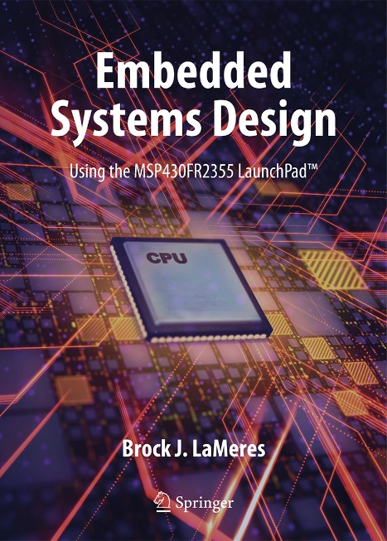

Embedded Systems Design
Chapter 4: The MSP430
4.1 MSP430 Hardware overview
Image Courtesy of
Recording Connection of Canada
Brock J. LaMeres, Ph.D.

Slide 2
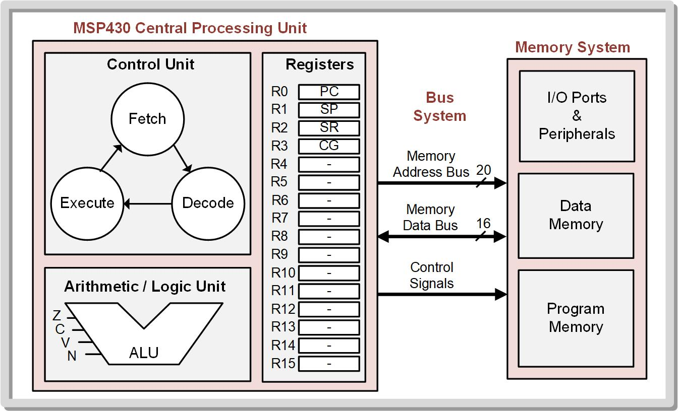
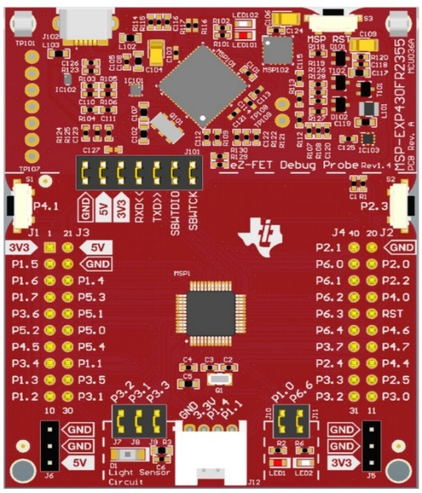
Embedded Systems Design
Chapter 4: The MSP430
4.1 MSP430 Hardware overview
Image Courtesy of
Recording Connection of Canada
Computer Overview
LaunchPad
Brock J. LaMeres, Ph.D.

Slide 3

Ch. 4: The MSP430
MSP430 Family (MSP = Mixed Signal Processor)
Produced by Texas Instruments.
Low-power signal processing.
Low cost.
Based on 16-bit CPU.
ROM and R/W memory.
Abundant suite of peripherals.
Texas Instruments logo
http://www.ti.com/legal/trademarks/signature-and-logo.html
4.1 MSP430 Hardware Overview

Slide 4
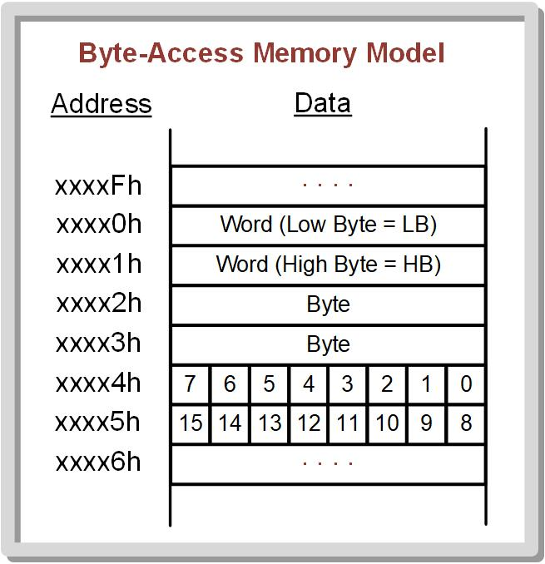
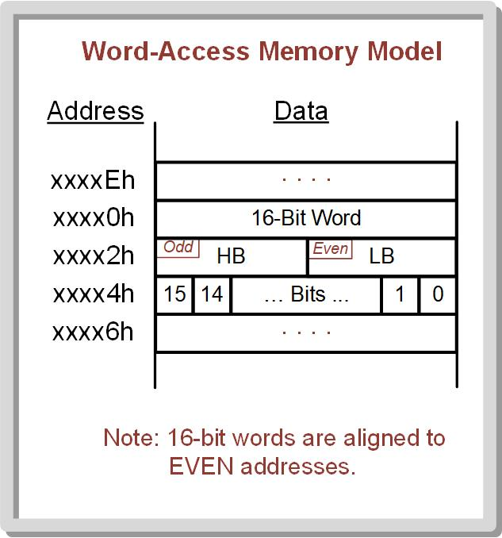
Ch. 4: The MSP430
4.1.1 Byte Memory Access vs. Word Memory Access
Bytes are located at even or odd address.
Words are located in the ascending memory locations aligned to even addresses with the low byte (LB) at the even address, followed by the high byte (HB) at the next odd. .address
Image Courtesy of
Recording Connection of Canada
4.1 MSP430 Hardware Overview

Slide 5
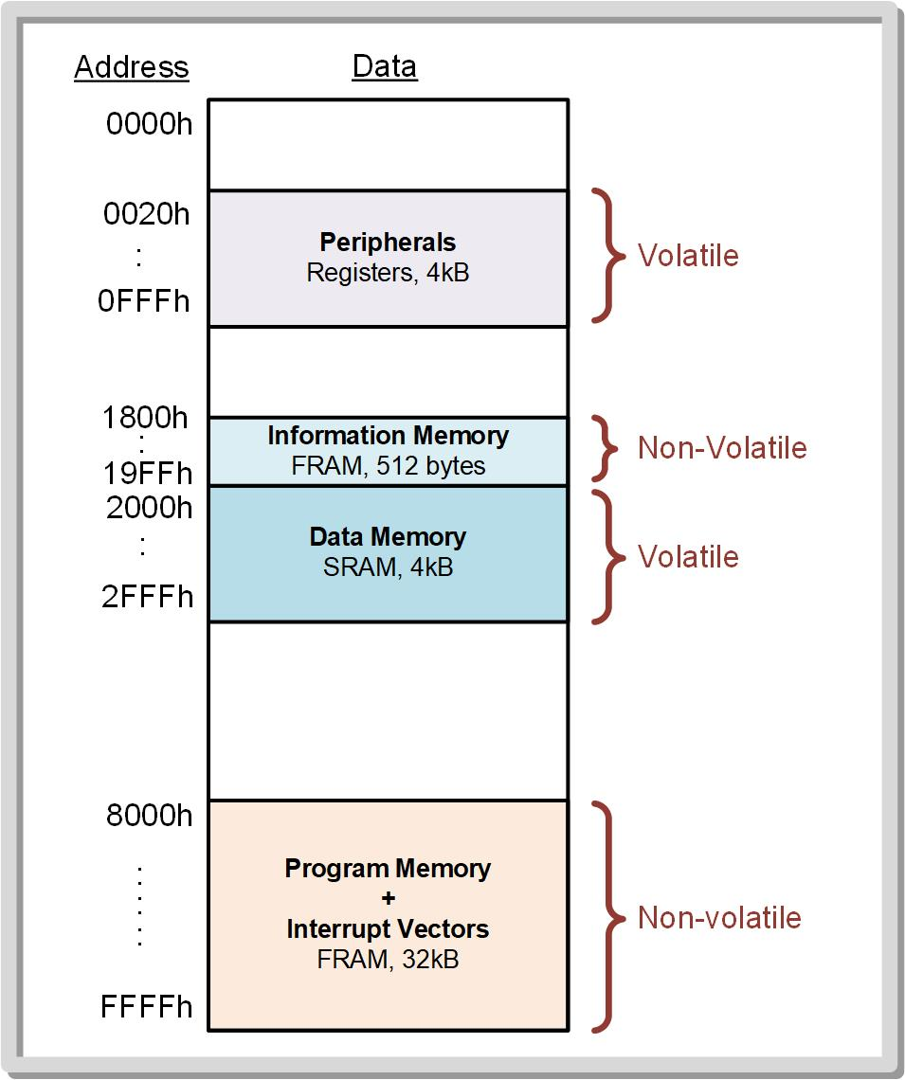
Ch. 4: The MSP430
4.1.2 Program Memory
Non-volatile memory sizes range from 0 to 512 kB.
Include MROM, Flash, and FRAM.
FRAM-based devices have regions of the non-volatile memory that can be written to by the program for storage of data when power is removed.
Image Courtesy of
Recording Connection of Canada
4.1 MSP430 Hardware Overview

Slide 6
Ch. 4: The MSP430
4.1.3 Data Memory
R/W, volatile memory is also known as RAM.
RAM ranges from 125 bytes to 66 kB.
Implemented with SRAM technology; some MCUs may also contain a small amount of FRAM for data memory.
Image Courtesy of
Recording Connection of Canada
4.1 MSP430 Hardware Overview

Slide 7
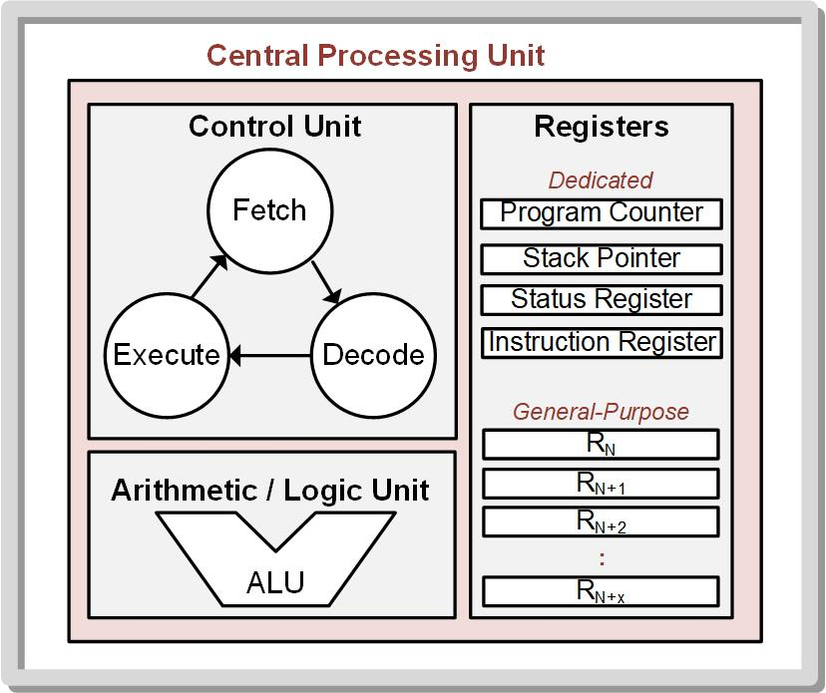
Ch. 4: The MSP430
4.1.4 Central Processing Unit
4.1.4.1 Registers
The MSP430 CPU has 16 registers that are 20-bits wide.
Registers are operated on as 16-bit words.
Register Names - R0, R1, R2, R3, …, R15.
R0 – R3 are special purpose registers (cannot be manipulated directly by the software).
R4 – R15 are general-purpose registers (can be used in any manner by the program).
4.1 MSP430 Hardware Overview

Slide 8
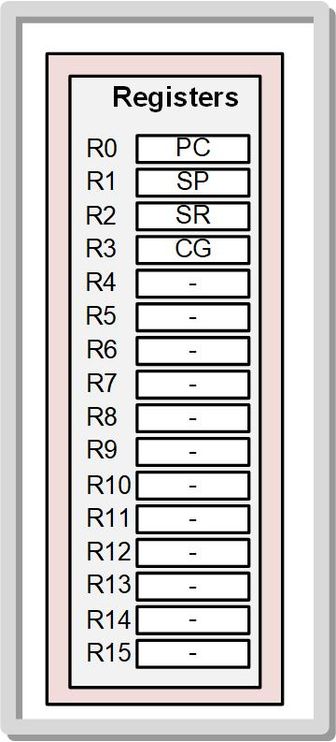

Ch. 4: The MSP430
4.1.4 Central Processing Unit
4.1.4.1 Registers
R0: Program Counter (PC) – holds the address of the next instruction in program memory to execute; provides access to $2^{20}=1,048,576$ address locations in the memory system.
R1: Stack Pointer (SP) – provides a way to dynamically allocate variable space in the data memory without having to keep track of specific addresses.
Image Courtesy of
Recording Connection of Canada
4.1 MSP430 Hardware Overview

Slide 9
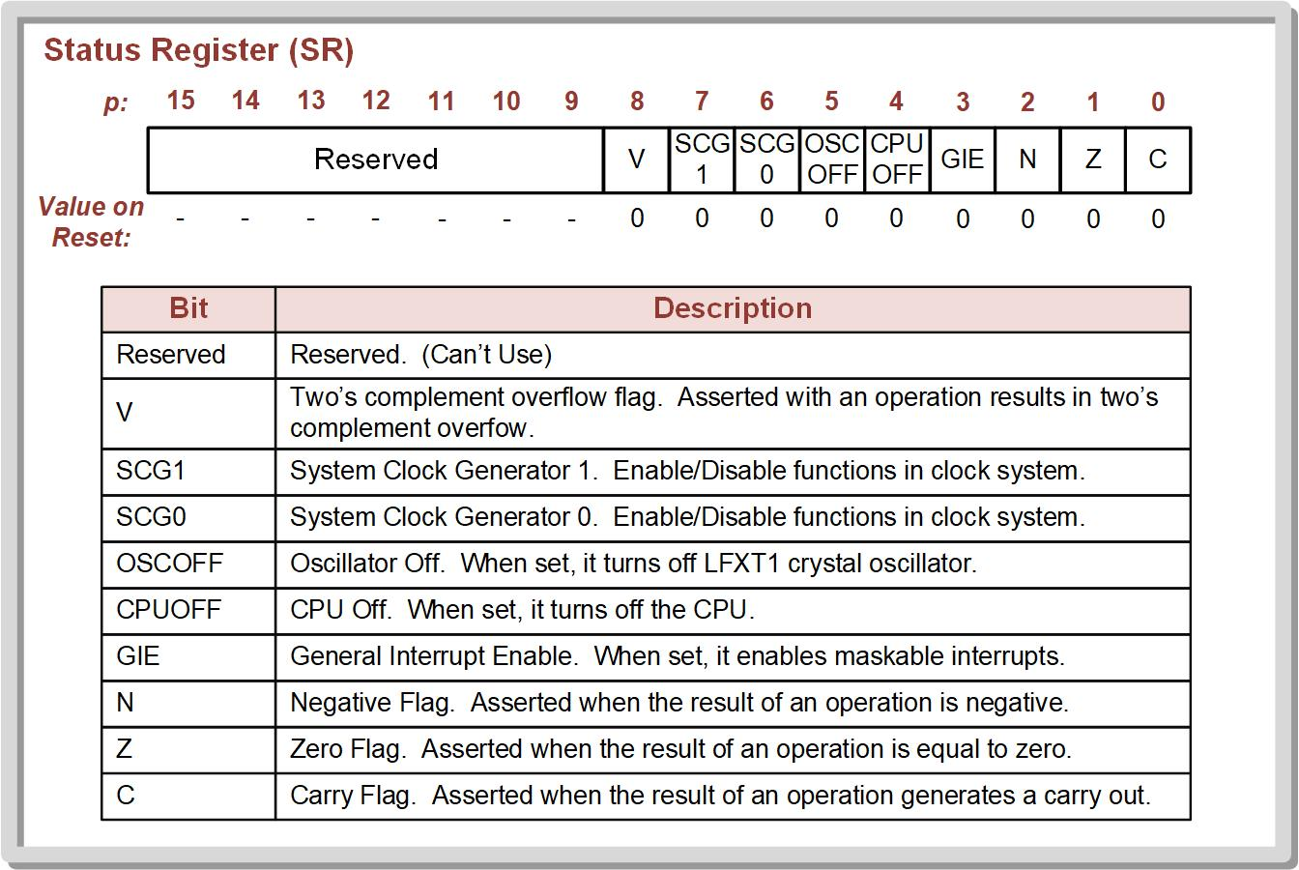
Ch. 4: The MSP430
4.1.4 Central Processing Unit
4.1.4.1 Registers
R2: Status Register (SR) – contains status bits, or flags, that are asserted when various conditions occur during the execution.
Image Courtesy of
Recording Connection of Canada
4.1 MSP430 Hardware Overview

Slide 10
Ch. 4: The MSP430
4.1.4 Central Processing Unit
4.1.4.1 Registers
R3: Constant Generator (GC) – used by the CPU to speed up the instruction execution.
R4 – R15: General-Purpose Registers – can be used for anything the programmer wants.
Image Courtesy of
Recording Connection of Canada
4.1 MSP430 Hardware Overview

Slide 11
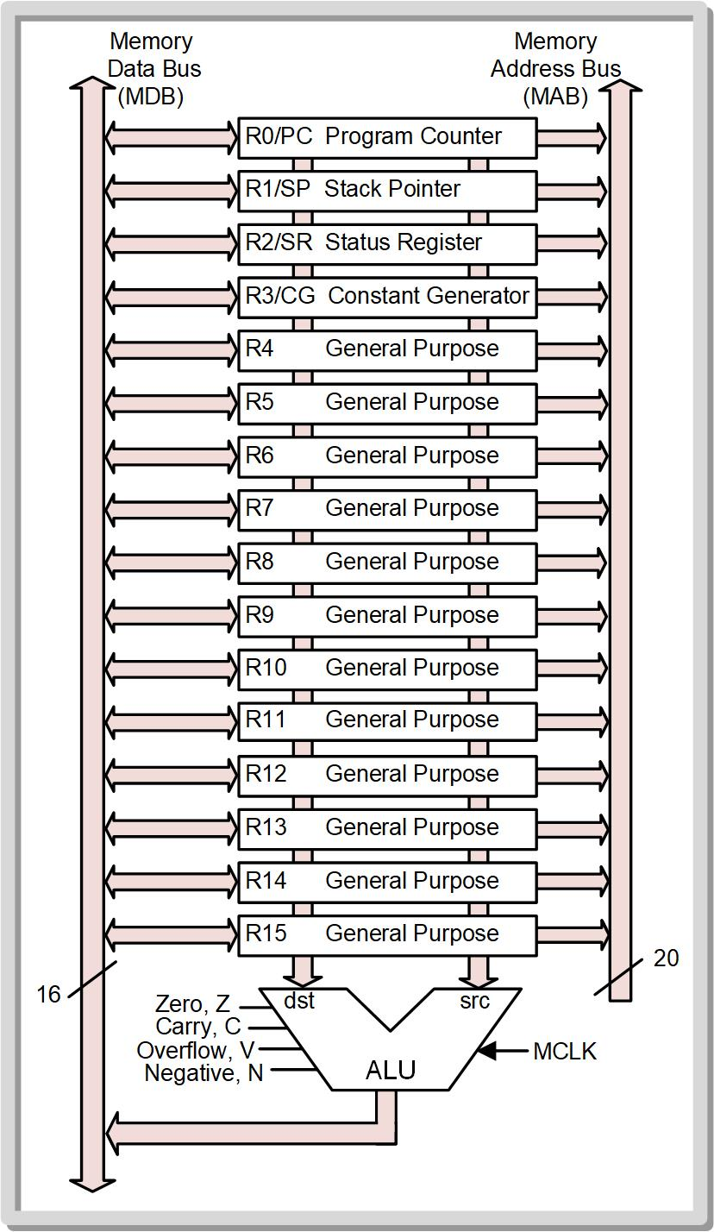
Ch. 4: The MSP430
4.1.4 Central Processing Unit
4.1.4.2 ALU
Performs all mathematical and logical operations.
Operates on data being held in CPU registers.
Contains logic to produce status bits (VNZC) that are latched into the status register for specific instructions.
Only operates on the lower 16-bits of the CPU registers.
Image Courtesy of
Recording Connection of Canada
4.1 MSP430 Hardware Overview

Slide 12
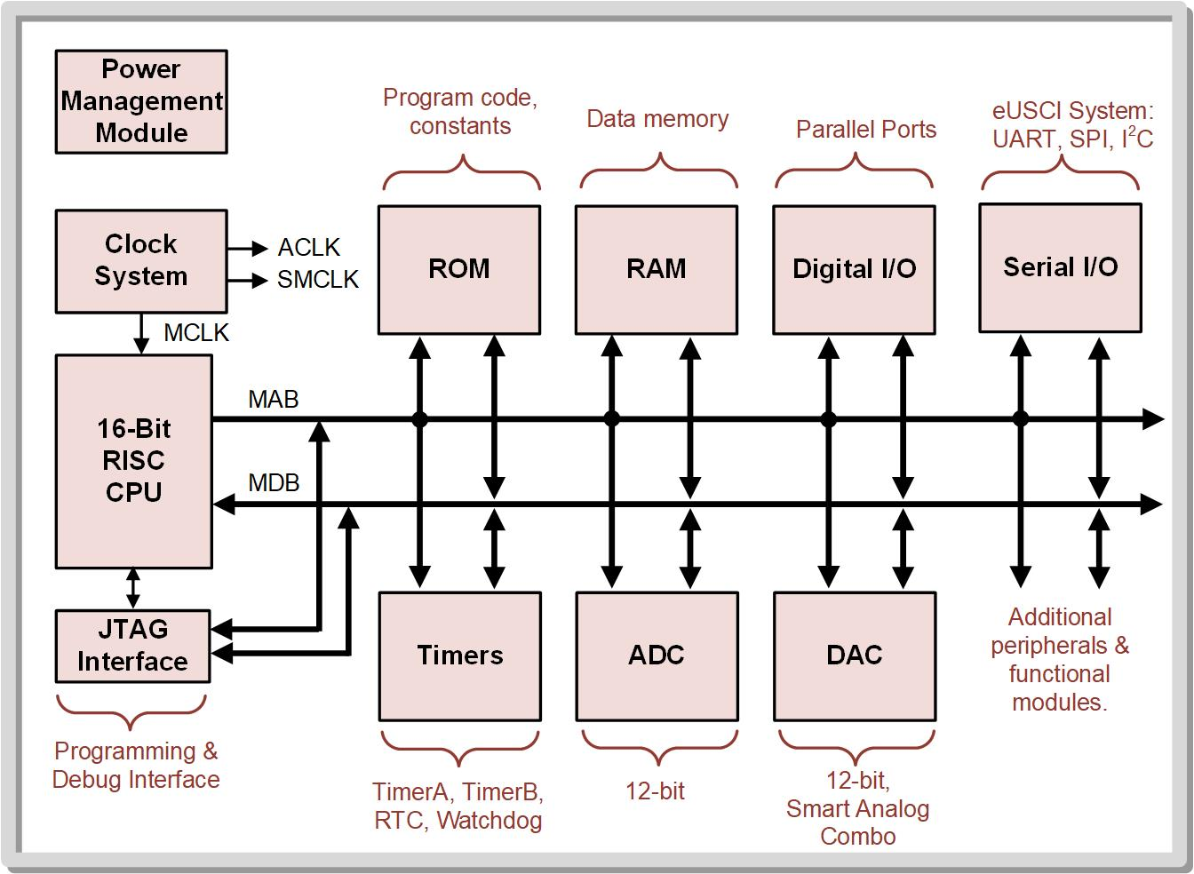
Ch. 4: The MSP430
4.1.5 Input / Output Ports & Peripherals
Image Courtesy of
Recording Connection of Canada
4.1 MSP430 Hardware Overview

Slide 13

Ch. 4: The MSP430
4.1.5 Input / Output Ports & Peripherals
4.1.5.1 Digital I/O
Acts as parallel buses that interface with the outside world.
Can be programmed to be inputs or outputs.
Contain pull-up or pull-down resistors.
The MSP430 has 12, 8-bit I/O ports.
Image Courtesy of
Recording Connection of Canada
4.1 MSP430 Hardware Overview

Slide 14
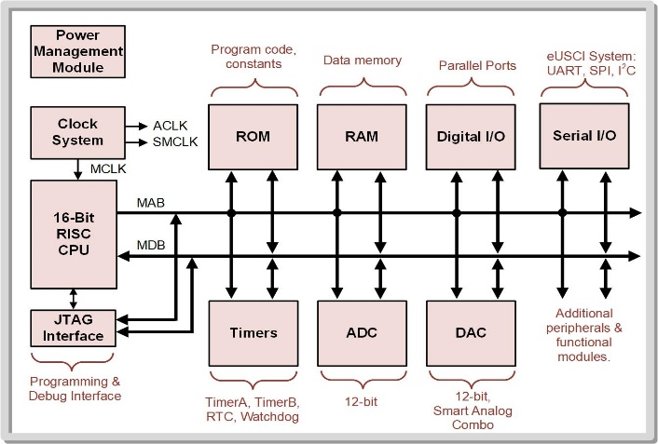
Ch. 4: The MSP430
4.1.5 Input / Output Ports & Peripherals
4.1.5.2 Serial I/O
The MSP430 contains numerous serial communication peripherals that support multiple serial communication protocols.
The MSP430 calls these modules the enhanced Universal Serial Communication Interface (eUSCI) modules.
eUSCI_A – universal asynchronous receiver/transmitter (UART) or serial peripheral interface (SPI).
eUSCI_B – SPI or inter-integrated circuit (I2C).
Image Courtesy of
Recording Connection of Canada
4.1 MSP430 Hardware Overview

Slide 15
Ch. 4: The MSP430
4.1.5 Input / Output Ports & Peripherals
4.1.5.3 Timers
A timer is a binary counter that runs independent from the CPU and can be used to track or generate events based on its value.
Events can be generated when the counter reaches certain values (compare mode), when the counter overflows, and when the counter stores the current value based on an external signal.
Module names: Timer_A, Timer_B, Real-Time Clock (RTC) counter, Watchdog counter
4.1 MSP430 Hardware Overview

Slide 16
Ch. 4: The MSP430
4.1.5 Input / Output Ports & Peripherals
4.1.5.4 Analog to Digital Converter
Takes in an analog signal on a pin of the device and produces a binary equivalent value of the voltage level
Sample – each time the digital value is generated
The MSP430 allows the ADC to perform conversions on multiple inputs
The MSP430 ADC can support 12-bits of resolution for the conversion and can route up to 16 inputs channels to the ADC using a switch circuit
4.1 MSP430 Hardware Overview

Slide 17
Ch. 4: The MSP430
4.1.5 Input / Output Ports & Peripherals
4.1.5.5 Digital to Analog Converters
Take a binary code and generate an output voltage on one of the pins of the device
Usually fast enough to produce output signals for audio and video applications
Smart analog combo (SAC) – DAC circuits within a module; contain additional circuitry to support creating analog voltages such as operational amplifiers and switch arrays
Image Courtesy of
Recording Connection of Canada
4.1 MSP430 Hardware Overview

Slide 18

Ch. 4: The MSP430
4.1.5 Input / Output Ports & Peripherals
4.1.5.6 Clock System
Generates and distributes various clock sources used on the MCU.
Takes in internal and external clock sources and creates on-chip clocks for use by the MCU and peripheral.
Three primary clocks: MCLK (master clock), SMCLK (subsystem master clock), and ACLK (auxiliary clock).
MCLK – clock course for CPU.
SMCLK – clock for peripherals that can work independently from CPU operation.
ACLK – used for peripherals that require low frequency operation.
Image Courtesy of
Recording Connection of Canada
4.1 MSP430 Hardware Overview

Slide 19
Ch. 4: The MSP430
4.1.5 Input / Output Ports & Peripherals
4.1.5.7 Power Management Module
Generate a power supply voltage for the core logic on-chip.
Provides power supply monitoring capabilities which help guide actions that need to be taken when the power supply begins to drop.
Image Courtesy of
Recording Connection of Canada
4.1 MSP430 Hardware Overview

Slide 20
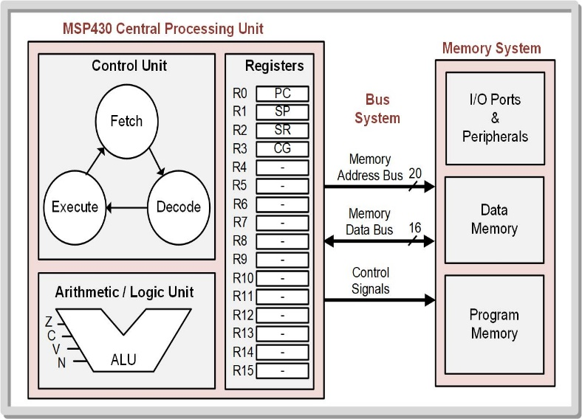

Ch. 4: The MSP430
4.1.6 Bus System
16-bit memory data bus - allows information to be moved between memory and the CPU in 16-bit words.
20-bit memory address bus - allows the CPU to access up to $2^{20}=1,048,576$ unique address locations.
All I/O, peripherals, data memory, and program memory are assigned unique address within the MSP430’s unified memory map.
4.1 MSP430 Hardware Overview

Slide 21
Ch. 4: The MSP430
4.1.7 MSP430 Part Numbering
The part numbers that make up the MSP430 family vary in the amount of memory they contain, the type of memory used, the clock frequency, operating temperature range, packaging type, and the testing that the device undergoes.
Image Courtesy of
Recording Connection of Canada
4.1 MSP430 Hardware Overview

Slide 22
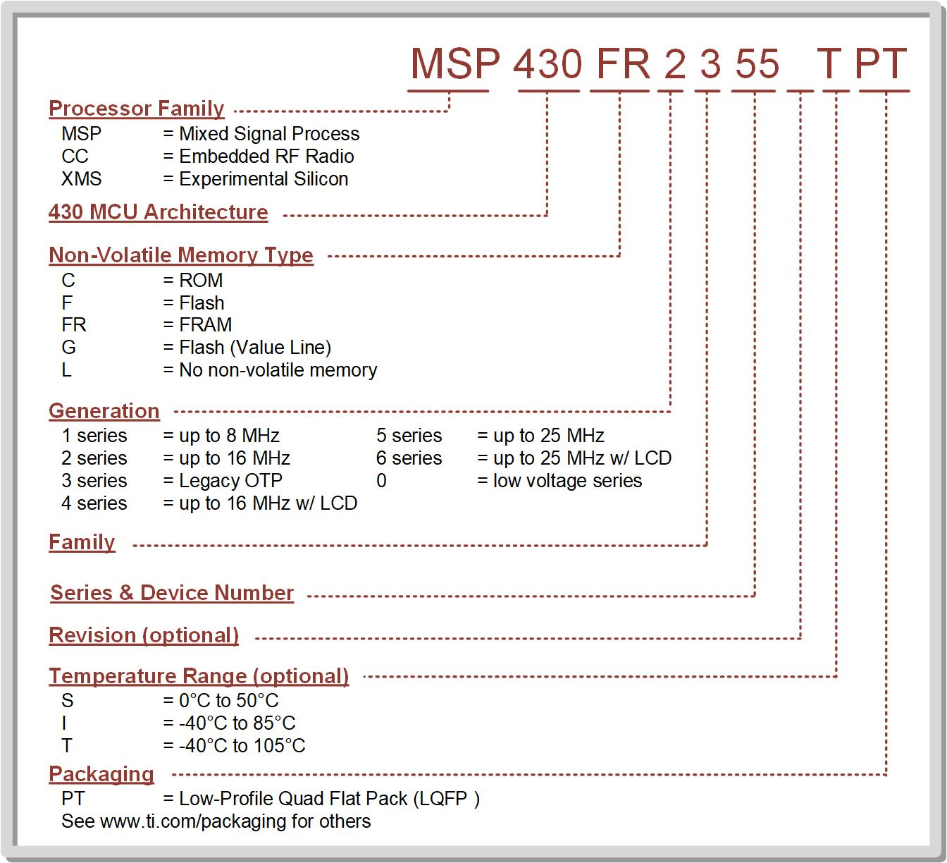
Ch. 4: The MSP430
4.1.7 MSP430 Part Numbering
Image Courtesy of
Recording Connection of Canada
4.1 MSP430 Hardware Overview

Slide 23

Embedded Systems Design
Chapter 4: The MSP430
4.1 MSP430 Hardware overview
www.youtube.com/c/DigitalLogicProgramming_LaMeres
Brock J. LaMeres, Ph.D.

Slide 24
Embedded Systems Design
Chapter 4: The MSP430
4.2 MSP430 Software overview
Image Courtesy of
Recording Connection of Canada
Brock J. LaMeres, Ph.D.

Slide 25
Ch. 4: The MSP430
4.2.1 The MSP430 Instruction Set
Contains 27 core instructions plus 24 emulated instructions.
Emulated instructions – instructions that make code easier to write and read, but do not have opcodes themselves; have unique mnemonics and are used when programming in assembly.
The following tables give the 51 instructions for the MSP430 family grouped by their class of instruction (i.e., data movement, data manipulation, and program flow).
4.2 MSP430 Software Overview

Slide 26
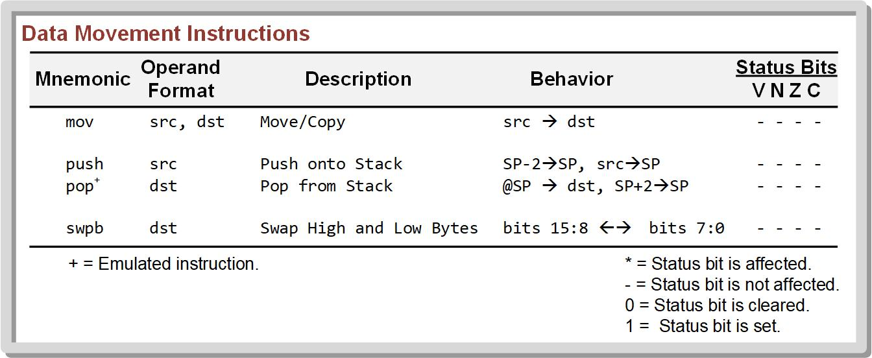
Ch. 4: The MSP430
4.2.1 The MSP430 Instruction Set
4.2 MSP430 Software Overview

Slide 27
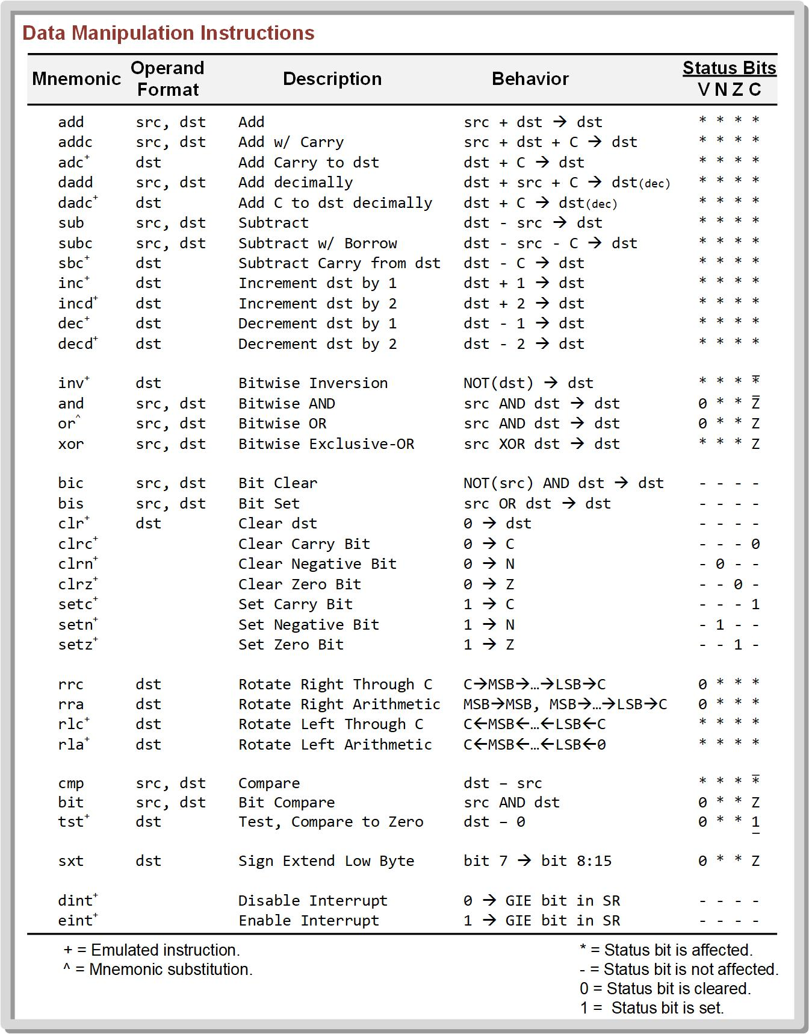
Ch. 4: The MSP430
4.2.1 The MSP430 Instruction Set
4.2 MSP430 Software Overview

Slide 28
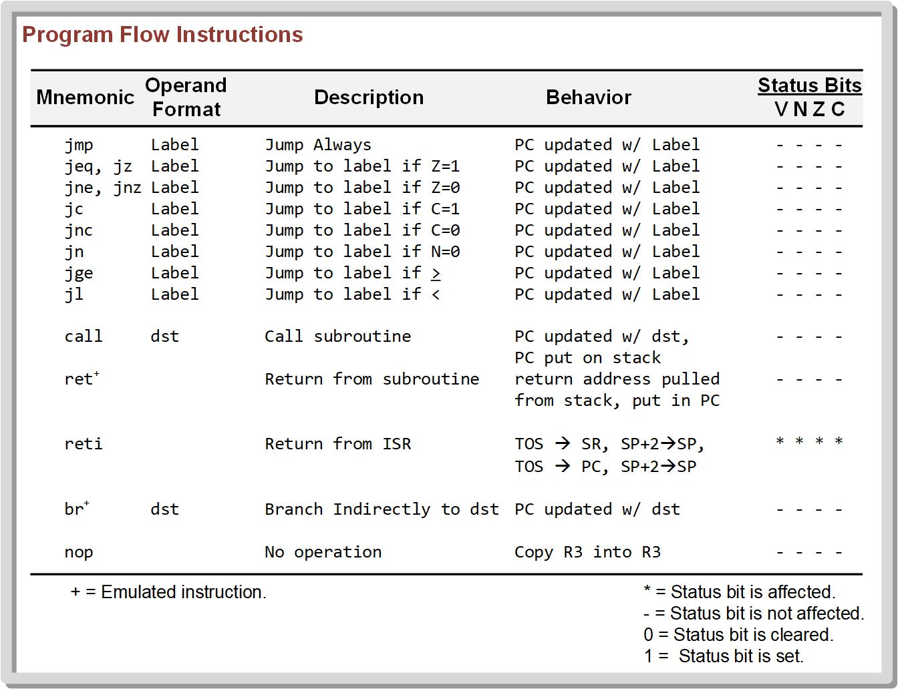
Ch. 4: The MSP430
4.2.1 The MSP430 Instruction Set
4.2 MSP430 Software Overview

Slide 29
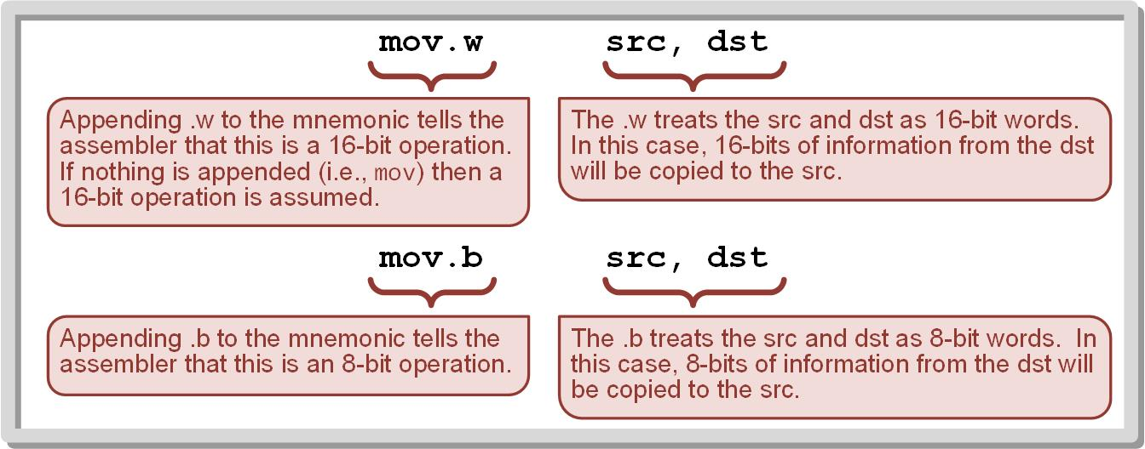
Ch. 4: The MSP430
4.2.2 Word (.W) vs. Byte (.B) Operations
To specify a 16-bit operation, a .W is appended to the instruction mnemonic.
To specify a 8-bit operation, a .B is appended to the instruction mnemonic.
Image Courtesy of
Recording Connection of Canada
4.2 MSP430 Software Overview

Slide 30
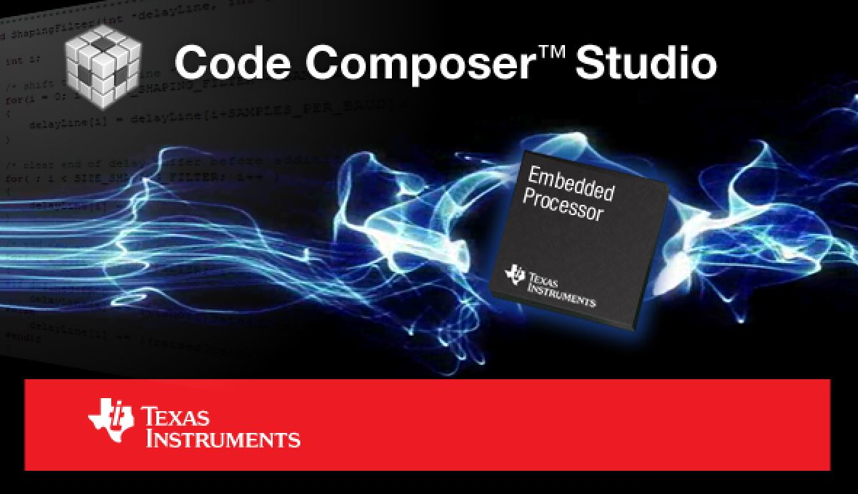
Ch. 4: The MSP430
4.2.3 The TI Code Composer Studio Development Environment
TI provides a free development environment for MSP430 MCUs called Code Computer Student (CCS) Integrated Development Environment (IDE).
The integrated term refers to the tool containing one environment that can be used to compile, assemble, link, download, and debug a program on an MCU
Image Courtesy of
Recording Connection of Canada
Image courtesy of Texas Instruments
4.2 MSP430 Software Overview

Slide 31
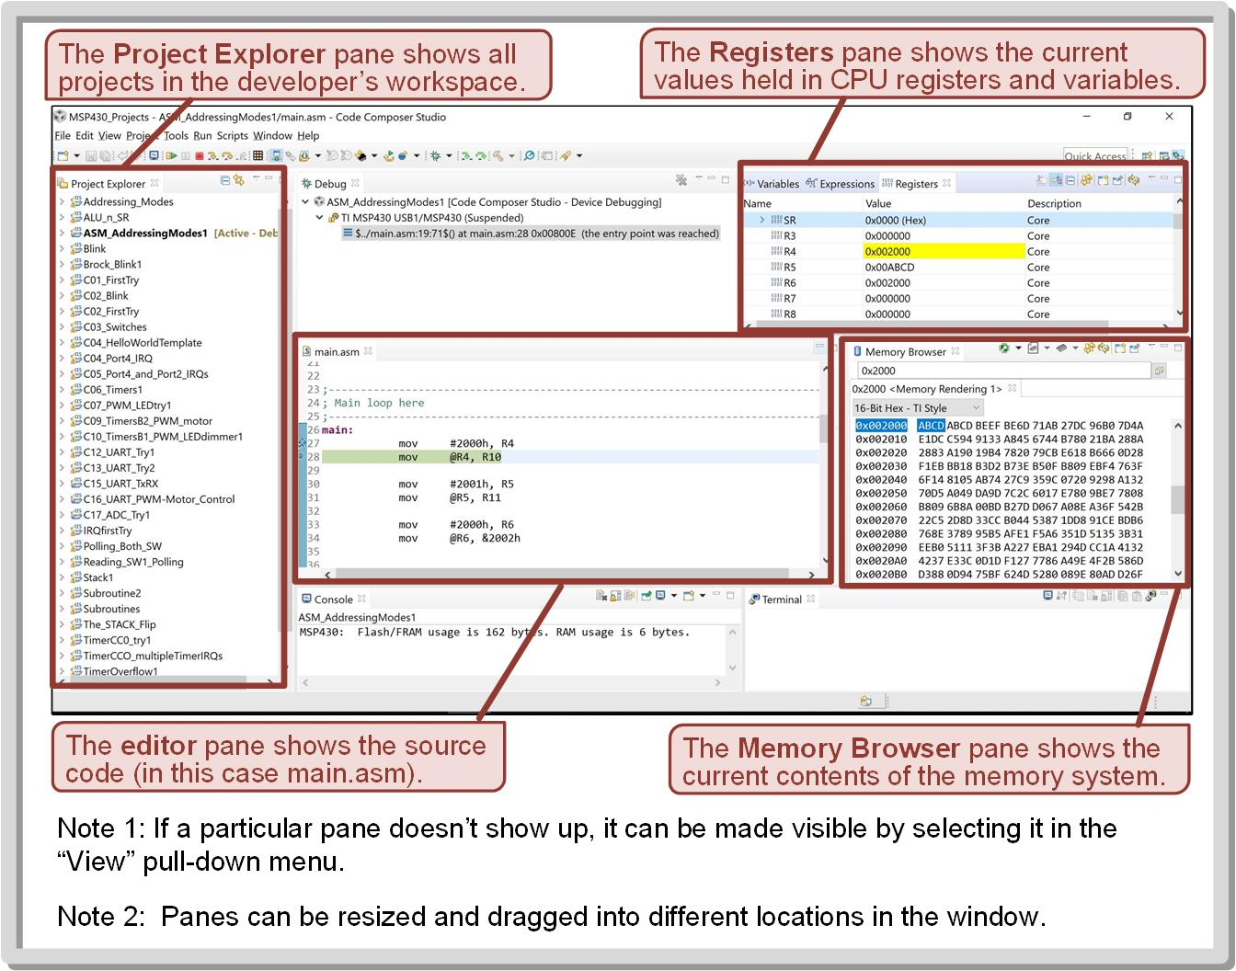
Ch. 4: The MSP430
4.2.3 The TI Code Composer Studio Development Environment
Image Courtesy of
Recording Connection of Canada
4.2 MSP430 Software Overview

Slide 32
Embedded Systems Design
Chapter 4: The MSP430
4.2 MSP430 Software overview
www.youtube.com/c/DigitalLogicProgramming_LaMeres
Brock J. LaMeres, Ph.D.

Slide 33
Embedded Systems Design
Chapter 4: The MSP430
4.3 MSP430FR2355 LaunchPadTM Development Kit
Brock J. LaMeres, Ph.D.

Slide 34
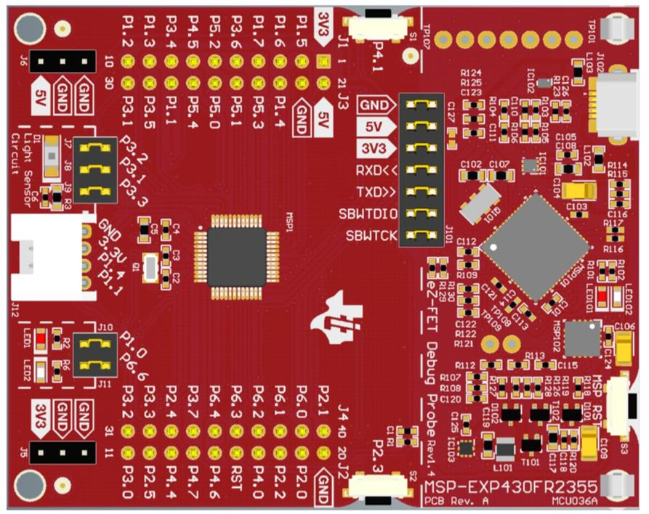
Ch. 4: The MSP430
4.3 MSP430FR2355
This board contains an MSP430FR2355TPT MCU in addition to a variety of extra circuitry to facilitate programming, debugging, and providing power to the MCU.
The board also contains some LEDs, buttons, pin headers, and additional circuitry to provide an interface to a select number of peripherals on the MCU
Image courtesy of Texas Instruments
4.3 MSP430FR2355 LaunchPadTM Development Kit

Slide 35
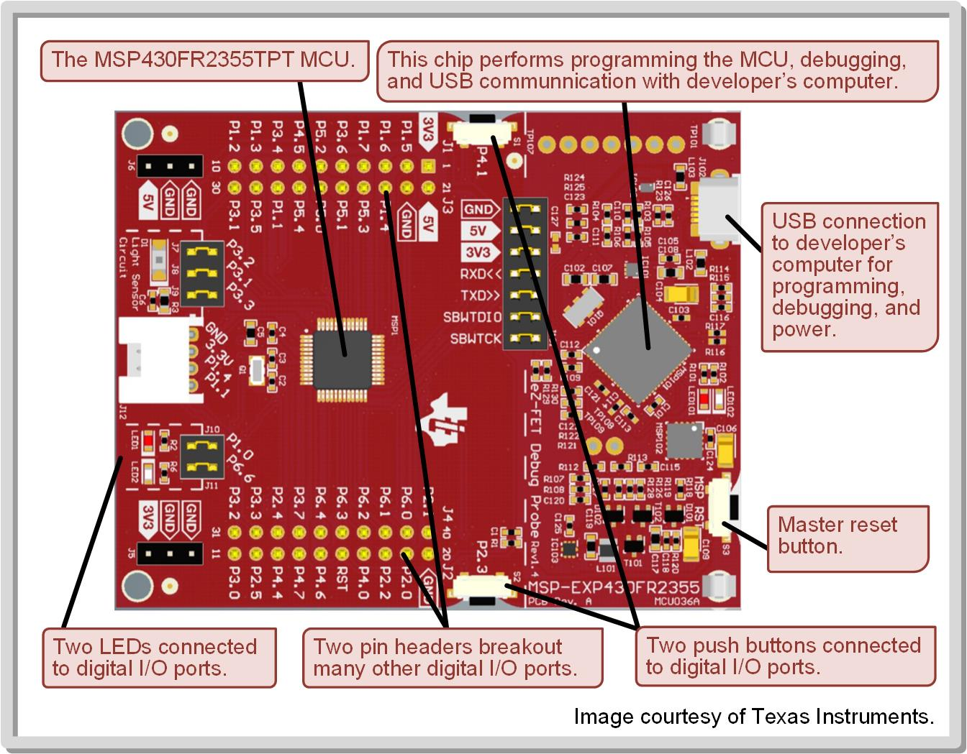
Ch. 4: The MSP430
4.3 MSP430FR2355
Image Courtesy of
Recording Connection of Canada
4.3 MSP430FR2355 LaunchPadTM Development Kit

Slide 36
Ch. 4: The MSP430
4.3 MSP430FR2355TPT
MCLK = 1MHz
64k memory system (16-bit MAB)
32k FRAM program memory
4k (SRAM) + 512 (FRAM) data memory
6x digital I/O ports - P1 (8-bit) → PA = P1:P2 - P2 (8-bit) - P3 (8-bit) → PB = P3:P4 - P4 (8-bit) - P5 (5-bit) → PC = P5:P6 - P6 (7-bit)
4x eUSCI’s - 2x switchable between UART & SPI - 2x switchable between SPI & I2C
4x timers
RTC
Watchdog timer
12-bit ADC
4x SACs
Image courtesy of Texas Instruments
4.3 MSP430FR2355 LaunchPadTM Development Kit

Slide 37

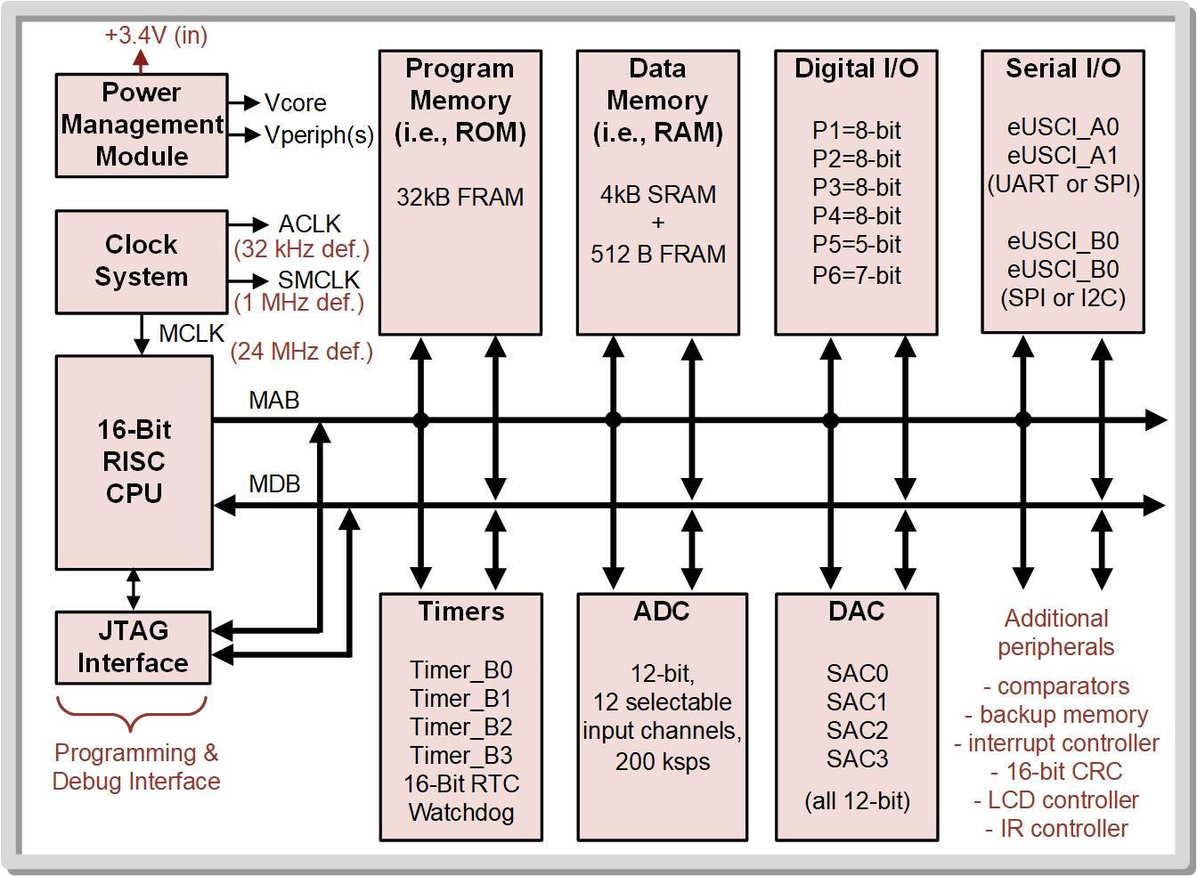
Ch. 4: The MSP430
4.3 MSP430FR2355TPT
4.3 MSP430FR2355 LaunchPadTM Development Kit

Slide 38
Embedded Systems Design
Chapter 4: The MSP430
4.3 MSP430FR2355 LaunchPadTM Development Kit
www.youtube.com/c/DigitalLogicProgramming_LaMeres
Brock J. LaMeres, Ph.D.

Slide 39
Embedded Systems Design
Chapter 4: The MSP430
4.3 MSP430FR2355 LaunchPadTM Documentation
Brock J. LaMeres, Ph.D.

Slide 40
Ch. 4: The MSP430
4.3 LaunchPad Documentation
MSP430FR4xx and MSP430FR2xx Family User's Guide (Rev. I) (http://www.ti.com/lit/ug/slau445i/slau445i.pdf)
MSP430FR235x, MSP430FR215x Mixed-Signal Microcontrollers datasheet (Rev. D) (http://www.ti.com/lit/ds/slasec4d/slasec4d.pdf)
MSP430FR2355 LaunchPad™ Development Kit (MSP-EXP430FR2355) User's Guide (http://www.ti.com/lit/ug/slau680/slau680.pdf)
4.3 MSP430FR2355 LaunchPadTM Development Kit

Slide 41
Embedded Systems Design
Chapter 4: The MSP430
4.3 MSP430FR2355 LaunchPadTM Documentation
www.youtube.com/c/DigitalLogicProgramming_LaMeres
Brock J. LaMeres, Ph.D.

